Slide 1
LOGICAL FUNCTIONS
Understanding and Applying Logical Functions in Excel

Slide 2
PARTICIPANTS:
Atharva Salokhe
Vishal Sen
Geetha Iyer
Anjali Roy
Om Bodke
Kunal Pardhi
Saee Pawar

Slide 3
Introduction to Logical Functions
What are Logical Functions?
Functions that perform logical tests and return values based on conditions.
Key role in decision-making processes in Excel.
Commonly used to check if conditions are met (TRUE or FALSE).

Slide 4
IF Function
IF Function
The IF function checks whether a condition is true or false and then returns one value if true and another if false.
Syntax:
=IF(logical_test, value_if_true, value_if_false)
logical_test: The condition you want to test.
value_if_true: The value returned if the condition is true.
value_if_false: The value returned if the condition is false.
Example: =IF(A1 > 10, "Yes", "No")

Slide 5
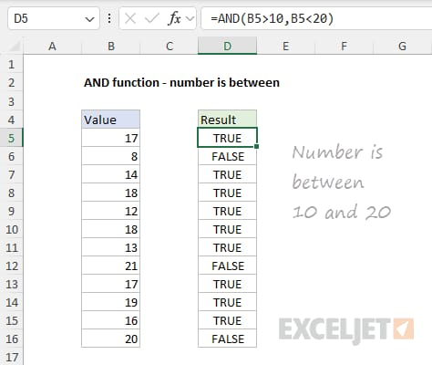
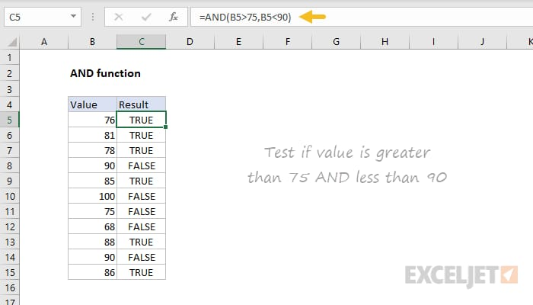
AND Function
AND Function:
The AND function checks if all conditions are true. It returns TRUE only if all conditions are true; otherwise, it returns FALSE.
Syntax:
=AND(condition1, condition2, ....)
Example: =AND(B5> 10, B5 < 20)

Slide 6
OR Function
OR FUNCTION :
The OR function checks if at least one of the condition is true ,it returns
TRUE, only if all the conditions are true; otherwise it returns FALES
Syntax:
=OR(condition1, condition2, ...)
Example:
=OR(A1>10, B1<5)

Slide 7
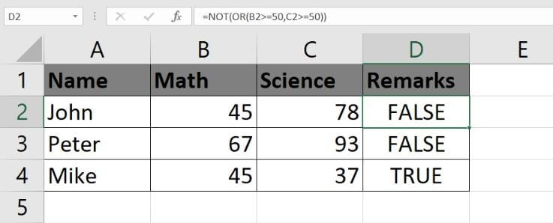
NOT Function
NOT Function:
The NOT function reverses the logical value of its argument. If the argument is
TRUE, it returns FALSE and if the argument is FALSE, it returns TRUE
Syntax:
=NOT(logical)
Example:
=NOT(OR(B2>=50, C2>=50))If the student has 50 or more in Math or Science, the result is FALSE. If the student has less than 50 in both subjects, the result is TRUE (indicating failure).

Slide 8
Using AND and OR Functions
AND Function: Returns TRUE if all conditions are TRUE.
Example: =AND(A1 > 5, B1 < 10)
OR Function: Returns TRUE if at least one condition is TRUE.
Example: =OR(A1 > 10, B1 < 5)

Slide 9
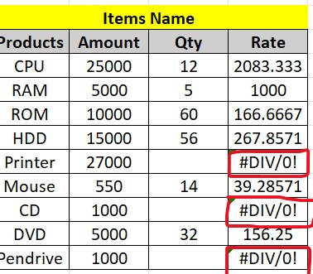
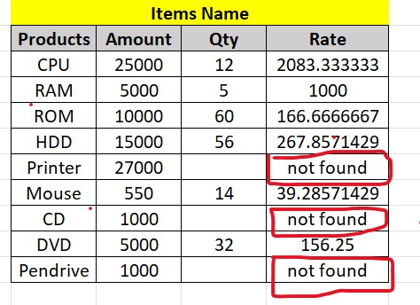
IFERROR Function
FERROR Function: The IFERROR function is used to handle errors in formulas. It returns a specified value if the formula results in an error, and returns the result of the formula if no error occurs.
Syntax:
=IFERROR(value, value_if_error)
value: The formula or expression to check for errors.
value_if_error: The value to return if the formula results in an error.
Purpose: Handles errors in formulas. Returns a custom value if an error occurs, or the result of the formula if no error occurs.
Example:
=IFERROR(A1/B1, "Error in division")
This will return "Error in division" if dividing by zero, and the result if there's no error

Slide 10
Combining IF and IFERROR Function
Combining IF and IFERROR Functions
Combining Nested IF and IFERROR for Complex Cases:
Example:
=IFERROR(IF(A1 > 10, "Greater than 10", IF(A1 > 5, "Greater than 5", "5 or less")), "Invalid input")
This formula will handle errors while making complex logical evaluations.

Slide 11
Syntax of NESTED IF
NASTED IF: A nested IF function is when you use multiple IF functions within each other. This allows you to check more than two conditions.
Syntax:
=IF(condition1, value_if_true, IF(condition2, value_if_true, value_if_false))
Example:
For categorizing student scores:
=IF(A1 > 90, "A", IF(A1 > 80, "B", IF(A1 > 70, "C", "Fail")))
Explanation:
If A1 > 90 → "A"
Else if A1 > 80 → "B"
Else if A1 > 70 → "C"
Else → "Fail"

Slide 12
Conclusion
: Conclusion
Key Takeaways:
Logical functions are essential for data analysis and decision-making.
IF, AND, OR, NOT, IFERROR, and Nested IF provide powerful ways to manage complex conditions.
Practice using these functions to enhance your Excel skills.
This structure outlines each function and gives a detailed explanation, making it easy to create the presentation slides. You can enhance the visuals with sample Excel formulas or real-life examples for better clarity.

